Slide 1
Program Language Technology
CS4158
Jim Buckley
CS1-032
086-1987640
jim.buckley@ul.ie

Slide 2
The importance of interactivity
Vital:
  If you don’t understand, others won’t either: this may well be me explaining it badly;
  If you see a flaw in what I’m saying, maybe there’s a flaw, or at least me presenting it badly (see point 1);
  If I ask a question its to provoke thoughts and see where ye are at so that I can talk to where ye are at;
  So PLEASE INTERACT.
  My Dagstuhl seminar
Notes:
Why not interact: power relationship, you may say something ‘wrong’ professors are always right
I was a PhD candidate
I don’t think anyone could screw up as badly as I did (and if they did – who am I to keep score): I will not be keeping records of who said what in lectures
It worked out really well
<νυμβερ>

Slide 3
Pop quiz * 3
b = 2 a – 4 c
The old man...
x=1 for ; x<10 ; ) ( x++
Notes:
B will hold the value of 2 times the value that is in ‘a’ minus 4 times the value that is in ‘c’: see how we inserted a multiplication when we didn’t have any signal that it was there, or that we assumed a, b, and c were placeholders;
The old man helped the child: non-verb-noun structuring. Consider ‘the old man the boats’ where ‘old’ moves from adjective to noun and ‘man’ changes from noun to verb. Then we just need a noun phrase. Here we keep the same structuring but the ‘typical use’ of ‘old’ and ‘man’ are changed to fool us
You can very easily change the last expression into a valid for loop;
<νυμβερ>

Slide 4
What have we learnt from these pop quizzes?
Maths, natural language, and programming languages all have standard structures;
We rely on that to interpret, generate and fix them:
  b=2a – 4c
  The old man the boats
  for(x=1;x<10;x++)
The std. programming language structure allows computers understanding/intellisense/critique our programs
Notes:
<νυμβερ>
This is why structure important – we attach meaning to it
In fact, without this correct structure, its sometimes hard to determine this meaning unambiguously
Even when we can, it interim step to understanding it, is in getting it in the right structure.
We’re particularly interested in program structure, because for a computer to understand our programs,
They have got to be in the right structure:
If they aren’t you get compilation errors
If they are it transforms them into executables that the computer can run (understand)

Slide 5
Grammar matters
That standard-structuring of languages, is called “grammar”
Here’s Steve Pinker (renowned Harvard professor) on why ‘GRAMMAR MATTERS”
https://www.youtube.com/watch?v=5JfFJ7R8pDs

Slide 6
So what?
We’re interested in the structure of programs;
Why… because it allows a computer to interpret it:
  Program compilation:
    Checking the structure is legal;
    Translating it into a behavioural meaning;
    Or interpreting it to do something else with it+++;
This causes our interest in other more established fields:
    Maths and human languages;
    Because they are older/can teach us much about communication structure
Notes:
Or (as we shall see later) interpreting it to do something else with it.
<νυμβερ>

Slide 7
We’re going to look at
The evolution of maths expressions:
  Structure of expressions;
  Associated notational issues;
  Generating legal expressions;
Language structures:
  Structure in English;
  Generating legal expressions;
  Ensuring legality of existing expressions;
Computer Programs:
  Ensuring legality of programs’ structure;
  Taking action, based on the structure;

Slide 8
For Computer Programs (and other domains)
Involves:
  Describing how we identify the individual elements of language;
  Identifying the different structuring rules needed;
  Putting them in sets to cover a whole language’s structure (Grammars);
  Identifying types of grammars that underpin computers’ ability to interpret correct structuring of code;
  Seeing the automatons and data-structures that allow us/computers:
    Check that each individual “element” (word) is correctly formed within this structuring;
    Check that they fit together with structural legality;
Notes:
…where each ‘set’ refers to an individual language
Draw picture here of rules – applied to language instance – generating executable or error report
<νυμβερ>

Slide 9
Context
(not covered)
Once a language is interpreted in this manner, and legality is asserted, an executable can be generated.
… Because there is a unique mapping between each structure and behavioural semantics
Getting to “executable-generation” issues is probably a stretch goal too-far for the module, but you will see how action can be prompted on rule recognition.

Slide 10
Why should you love PLT?
Why not:
  This module will have little direct relevant to your day-to-day working lives;
  There’s some tough, theoretical material in it;
But:
  It has a history;
  Very standardized architecture;
  Seeing data-structures/automata in action;
  My enthusiasm will out!!!;
  “hijklmno” (Pop quiz number 2!)
    Great module for thinking about rep approaches to problem solving;
Notes:
The solution is H20 – water: the letters being from H-to-O in the alphabet. I draw various representations to help here. To emphasize the importance of representations in problem solving
Rep issues:
We will see how algorithms, matrices, FSA and stacks, in conjunction with each other solving language legality
(Have they ever seen these 4 working in combination before in a 4 year degree in computer science?)
Applicability:
Code generation
Code metrics
Code refactoring;
Code re-engineering – reverse engineering;
But behind lots of things: code, calculators, any highly structured, complex input analysis: even analogies to XML processing, HTML scraping
Adventure games;
<νυμβερ>

Slide 11
Objectives
Objectives (The student should):
  Be able to describe the heritage of compilation from maths through to natural language to computer language parsing;
  Be able to identify and classify different types of grammars according to their merits
  Be able to apply this to:
    Generate language instances from grammatical specifications;
    Prove that language instances are valid with respect to specific grammatical specifications;
    Be able to generate grammars that describe simple languages;
    Describe automatons that allow parsing of simple languages wrt specific grammars;
    Thus write a simple interpreter / parser;

Slide 12
Supporting Books
‘Compilers Principles Tools and Teachniques’, A.V. Aho, R. Sethi and J.D. Ullman;
Crafting a Compiler with C. Fisher and LeBlanc;
‘Lex and YACC’ (or ‘Flex and Bison’) The O’ Reilly Guide. J.R. Levine, T. Mason and D. Brown;

Slide 13
General Administration
Attendance:
  Lectures
    Tuesday 09:00-1:00 – SG-17;
  Labs (weeks 7, 8, 9, 10, 11);
    Support for (your) parser writing;
      Thursday 09:00-10:00 – CS3004B
      Thursday 10:00-11:00 – CS3004B
      Possibly to be refined.
  Tutorials:
    Week 3 on, delivered by myself
      Tuesday 15:00-16:00 – HSG024
      Friday 17:00-18:00 – SG21
      Could we do just one?
Notes:
<νυμβερ>
Labs: writing a small parser – week 1: lex stuff;
Week 2: small integration with yacc stuff;
Week 3:

Slide 14
Assessment
(Timelines slightly provisional)
P1:
  Historical perspectives:
  30%;
  Mid-term test during week 6.
P2: Parsing and Grammars:
  40%;
  End of term test.
P3: Parser project:
  30%;
  Hand-in week 12-13.

Slide 15
General Administration
(Mark-to-Grade)
30% | D2
35% | D1
40% | C3
48% | C2
52% | C1
56% | B3
60 | B2
64% | B1
72% | A2
80% | A1

Slide 16
Core Points
Core points
Objectives
Notes:
<νυμβερ>
Unambiguous structure of communication, leading to intent
Structure leading to language instance generation, interpretation, language instance legality (over maths, english and computer languages)
Objectives:
Students should be able to trace heritage of this work, identify grammar types, be able to generate grammars from language instances, check language instances against grammar types and check language instances against grammars manually using automatons they create.
Tools and theory that allow us write such a legality enforcer (parser)/interpreter for a small programming language.

Slide 17
Core Points
Core points
  Structural rules for languages allow
    Language instance generation;
    Language instance legality checking;
    Language instance understanding;
  So “grammar matters”
Objectives (ability to):
  Trace heritage of language structuring from maths through languages to computer languages;
  Derive grammars reflecting language instances;
  Generate language instances from grammars;
  Check language instances against grammars for legality:
    Identify grammar types towards
    Automaton-creation (to be checked manually).
    Showing how tooling could possibly do so;
    To creating a tool that can;
Notes:
<νυμβερ>
Structure leading to language instance generation, language instance legality (over maths, english and computer languages)
Tools and theory that allow us write such a legality enforcer (parser) for a small programming language
Students should be able to trace heritage of this work, identify grammar types, be able to generate grammars from language instances, check language instances against grammar types and check language instances against grammars manually using automatons they create.

Slide 18
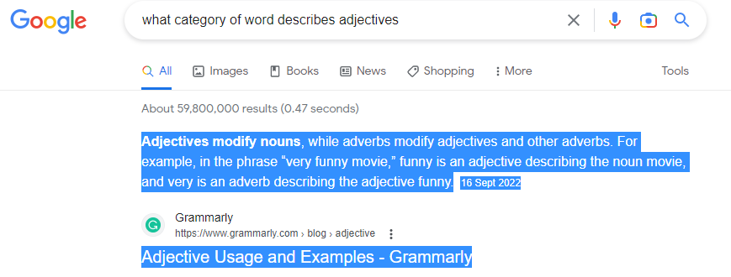
Is the “f&*^%n”, in “f%^$+n brilliant” a curse?

